Slide 1


Please take a seat and fire up your computer!
Download the necessary files from:
And create an account @
https://www.tinkercad.com/
To follow along
This workshop is sponsored by

Slide 2
This workshop will be familiarizing you with the Arduino board ,IDE and online simulation.
Course Objectives :
The topics to be covered in this presentation will serve as a good knowledge base for creating your own projects using an Arduino board.

Slide 3
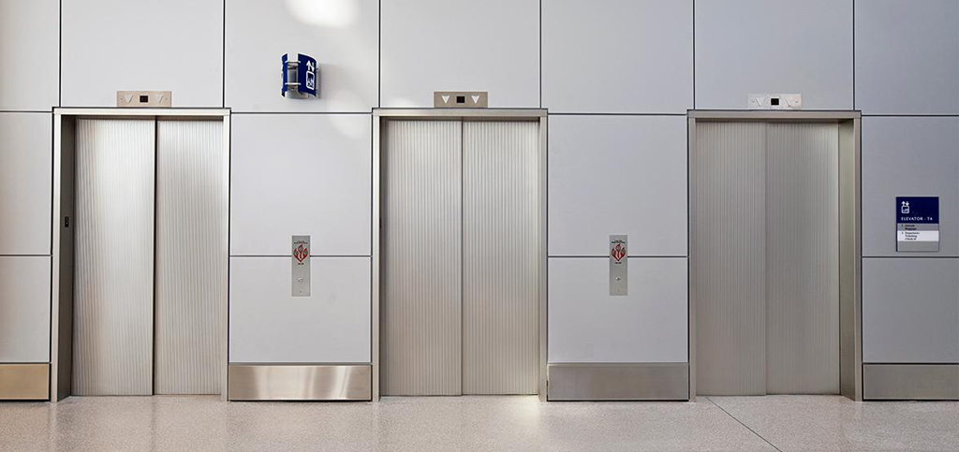
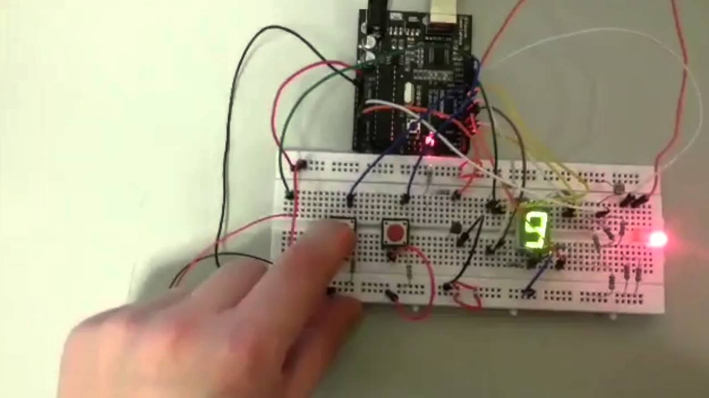
FINAL CHALLENGE

Slide 4
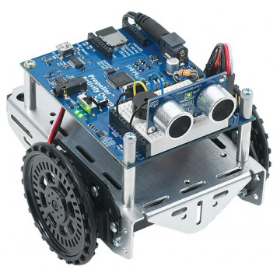

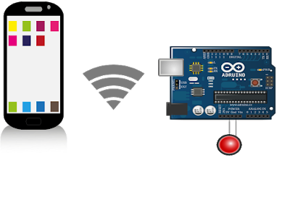
Arduino is an Italian company that produces easy-to-use microcontroller-based prototyping boards fit for various applications.
INTRODUCTION
WHAT IS AN ARDUINO?

Slide 5

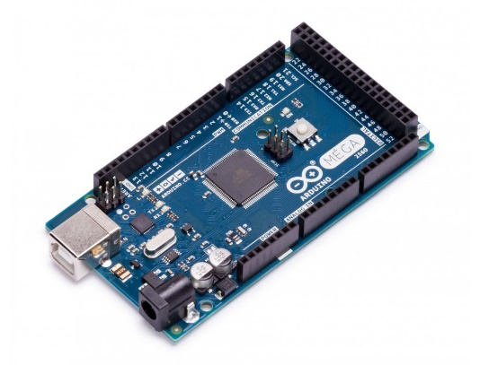
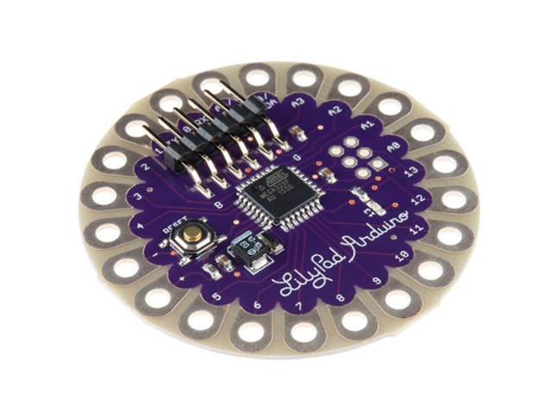
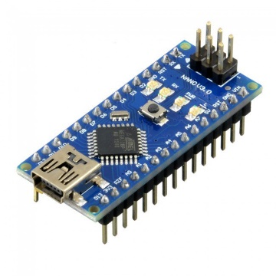
There exists a wide range of Arduino boards costumed for certain purposes: Arduino UNO Arduino Mega Arduino Nano Arduino Lilly pad etc.…
INTRODUCTION
WHAT IS AN ARDUINO?

Slide 6
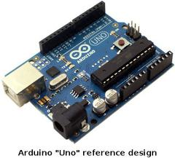
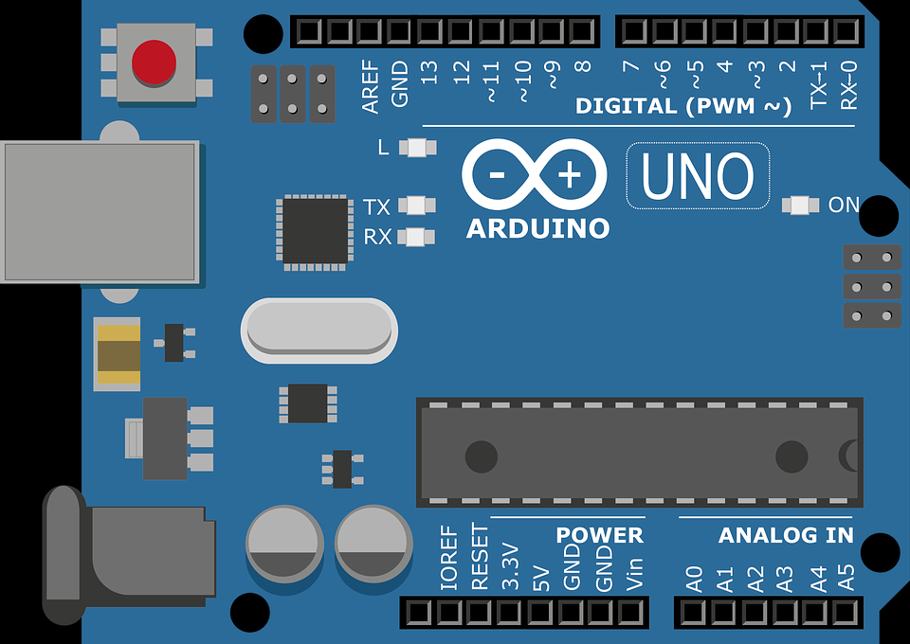
Arduino UNO R3
The main focus of today’s workshop will be on the Arduino UNO.
It is the standard board in prototyping and is also the most used.

Slide 7
Hardware & Simulator
In this workshop we will have groups working on the online simulator and groups working on the hardware.
The groups working on the hardware should parallely work on the online simulator.
This can help you understand how to test & simulate your schematic before starting to work with your hardware.
Groups should interchange after the break

Slide 8
Online Simulator
Make sure you create an account on:
Then follow along with your instructor.

Slide 9
Arduino UNO Pinout
All boards have pins in which we can insert a wire.
Every pin has a label; these labels will be very important later on because we will need to know where to insert our wires, what we want the Arduino to receive/send through the wires, and what pin to program to receive/send a certain signal.
Kindly look at the pins on your board.

Slide 10
Arduino UNO Pinout
Ground Pins (x3)
Digital pins
Reset button
USB type B to computer
ATmega microcontroller
External power source 7v-12v
Analog pins
3.3v pin
5v pin

Slide 11
Arduino Programming Language
Arduino uses a programming language is very similar to C++ but is made fit for the Arduino hardware.
Documentation/Reference:
https://www.arduino.cc/reference/en/

Slide 12
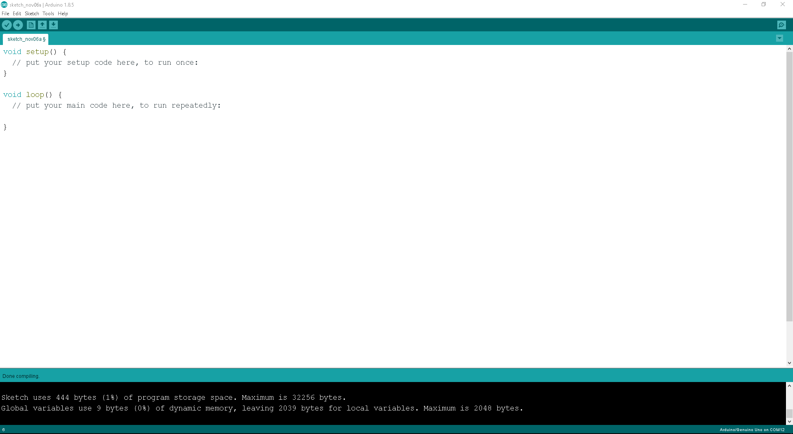
The Arduino IDE
IDE:
Integrated Development Environment
It’s a software application for the Arduino to compile, debug and upload your code to the Arduino hardware.

Slide 13
Let’s begin!
Now that we have an idea on what an Arduino is and familiarized ourselves with the UNO, we will start with the practical stuff.

Slide 14
IMPORTANT GUIDELINES:
If you are unfamiliar with basic electrical knowledge
Please do NOT power up the board before having its connections checked by the assistants.
Basic Guidelines :
Double check the polarities(+/-) of any connections you make.
Keep a consistent wiring color code. Use red for power and black for ground.
Calculate the expected current through all components before you apply power. Check the datasheet to make sure it's within safe limits.

Slide 15
Let’s begin!
Make sure you install the IDE from the link:
www.arduino.cc/en/Main/Software
OR
from the workshop files already installed

Slide 16
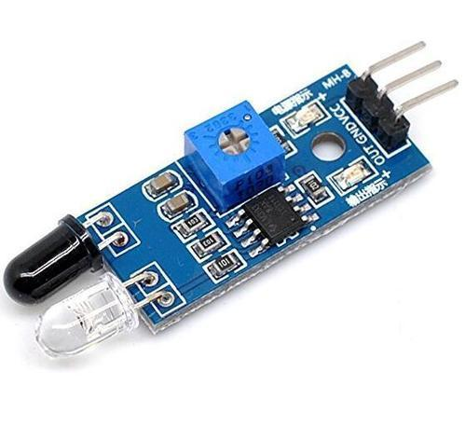
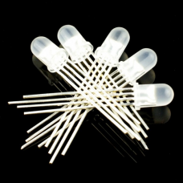
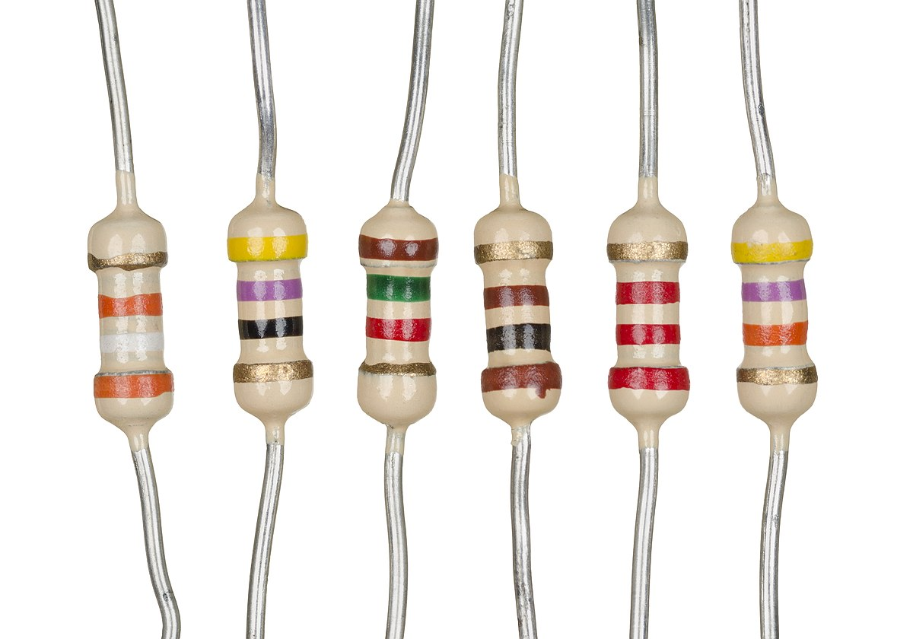
You will need:
Arduino UNO
Resistors
IR sensor
LEDs

Slide 17
The Arduino IDE
setup(){ }:
Code that is executed once when the Arduino is powered on.
Code uploader
loop(){ }:
Code that keeps executing in an infinite loop
Serial Monitor
Code verifier (Compiler)

Slide 18

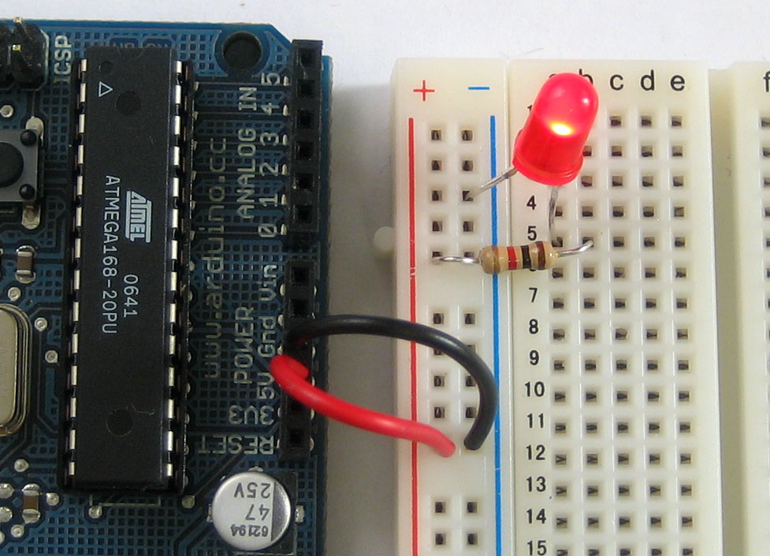

LET US GET TO WORK!
The method of work is as follows:
Explanation of a concept
Exercise (Hardware)
Exercise (Code)

Slide 19
Concept
Digital pins
Inputs Outputs and Digital pins
The Arduino interacts with its surrounding components through its digital and analog pins (GPIO)
A digital pin works within two states: True/HIGH (2.5-5V) or False/LOW (0-2.5V)
A digital pin can send information from the Arduino (Output) or receive information from a sensor or button (Input.)

Slide 20
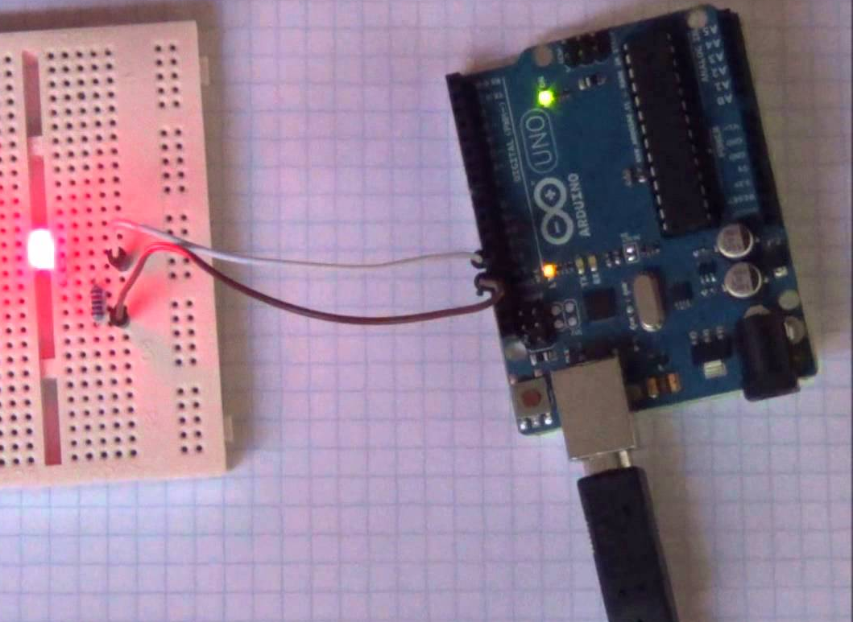
Challenge Accepted!
Turn A LED On and Off

Slide 21
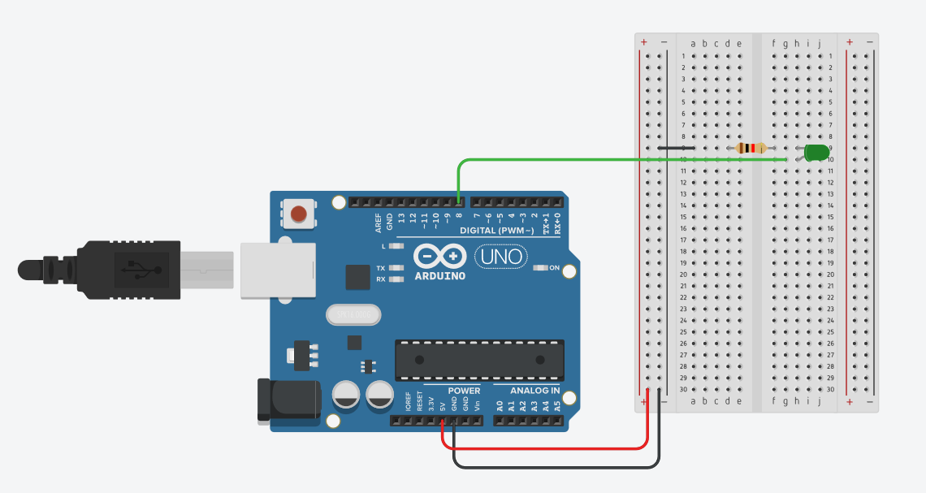
Challenge Accepted!

Slide 22
Challenge Accepted!
Blink A LED following a delay

Slide 23
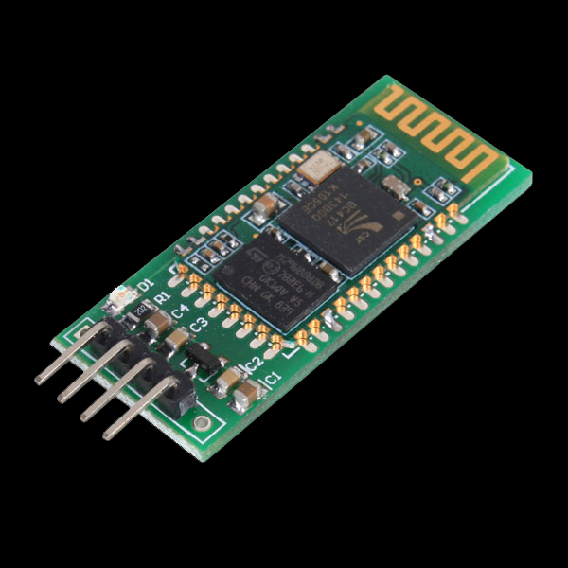
Concept
Breakout boards
The basic concept of a breakout board is that is takes a single electrical component and makes it easy to use.
Usually the electrical component is an integrated circuit (IC).
Integrated circuits, have pins on them that can do a multitude of things.
Most commonly there are pins for supply of power, pins for providing a ground, pins for receiving an input and pins for sending an output.

Slide 24
Concept
Breakout boards
The example we are going to use today is the infrared sensor available at your stations.
To read the functioning of one pin I can find the datasheet online.
OUT GND VCC
sending an output | providing a ground | supply of power

Slide 25
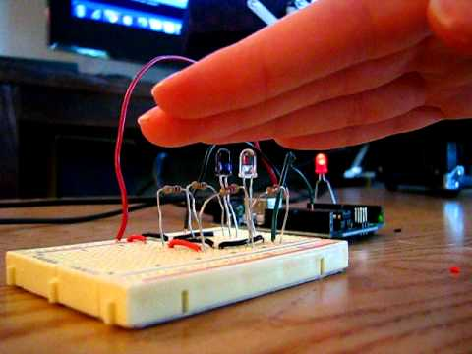
Challenge Accepted!
Turn on a LED when the IR sensor detects presence

Slide 26
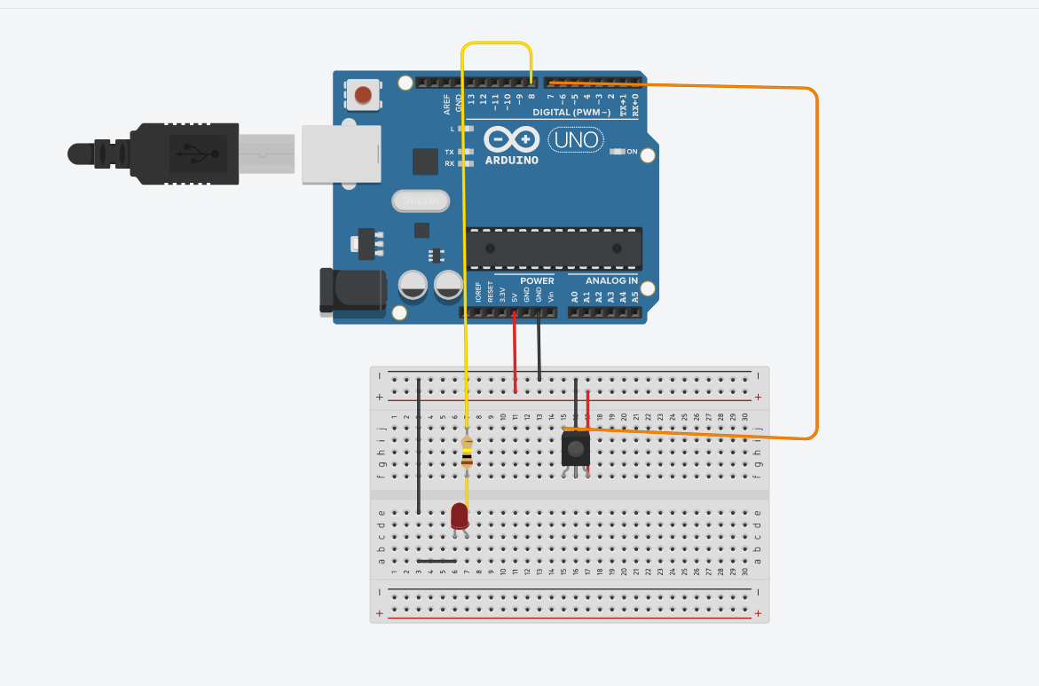
Challenge Accepted!

Slide 27
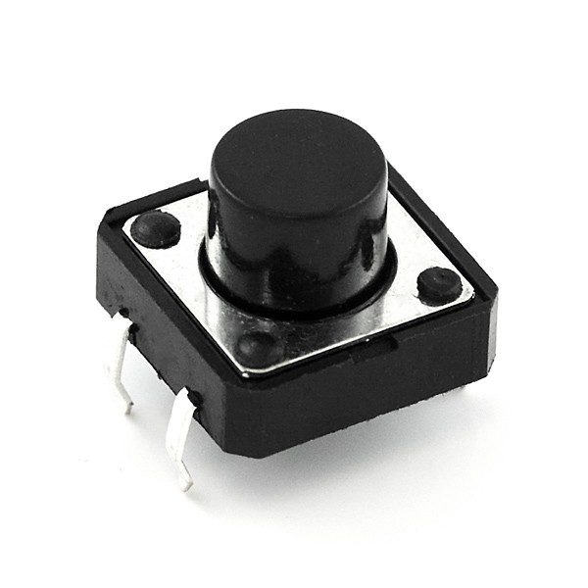
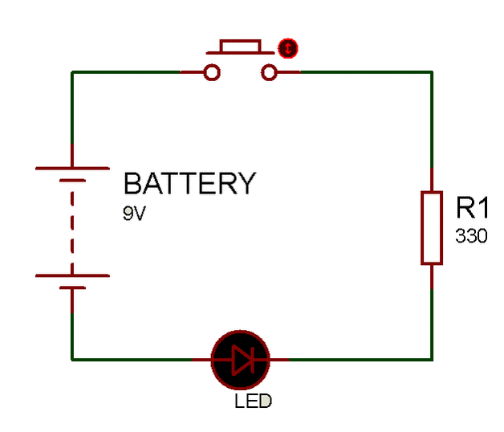
Push Buttons
a button that is pushed to operate an electrical device.

Slide 28
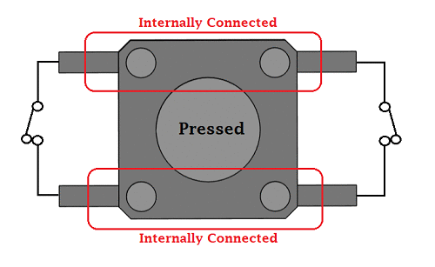
Push Buttons

Slide 29
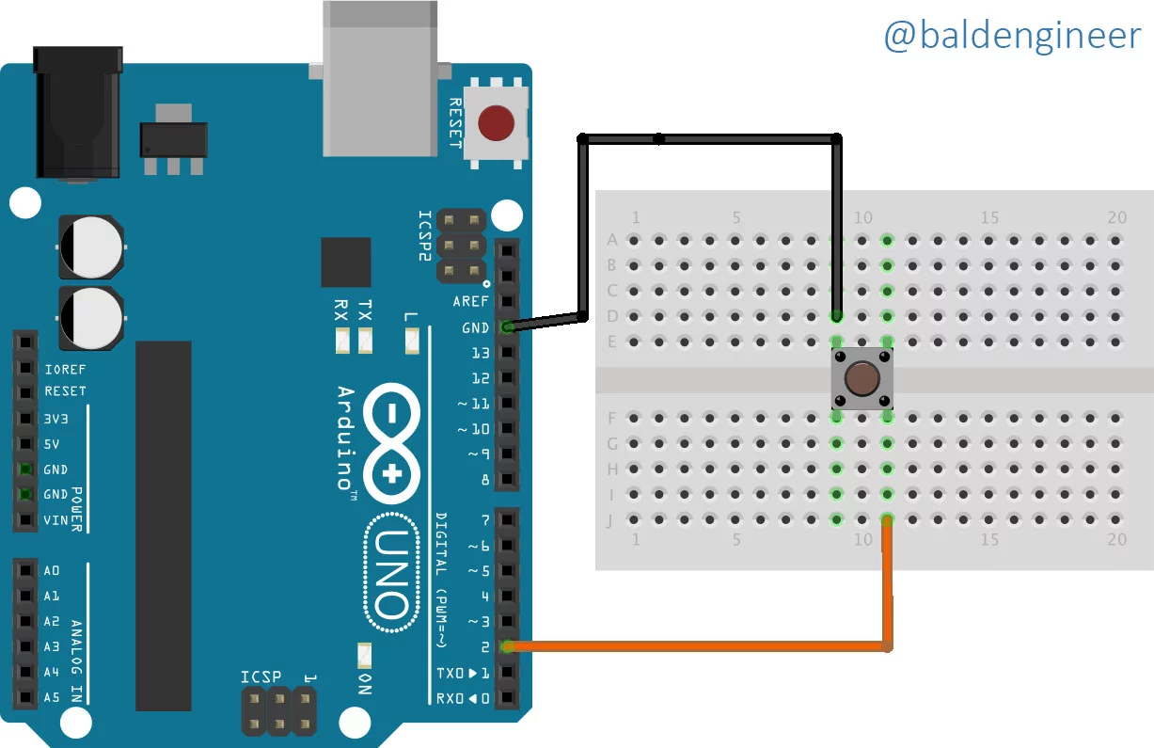
Challenge Accepted!
Try to light an LED using a push button with
The Arduino

Slide 30
Challenge Accepted!
Did you notice an issue?

Slide 31
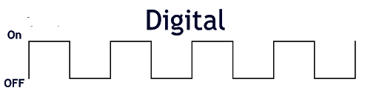
Push Buttons
There is a catch,
So you know that digital Signals are:

Slide 32
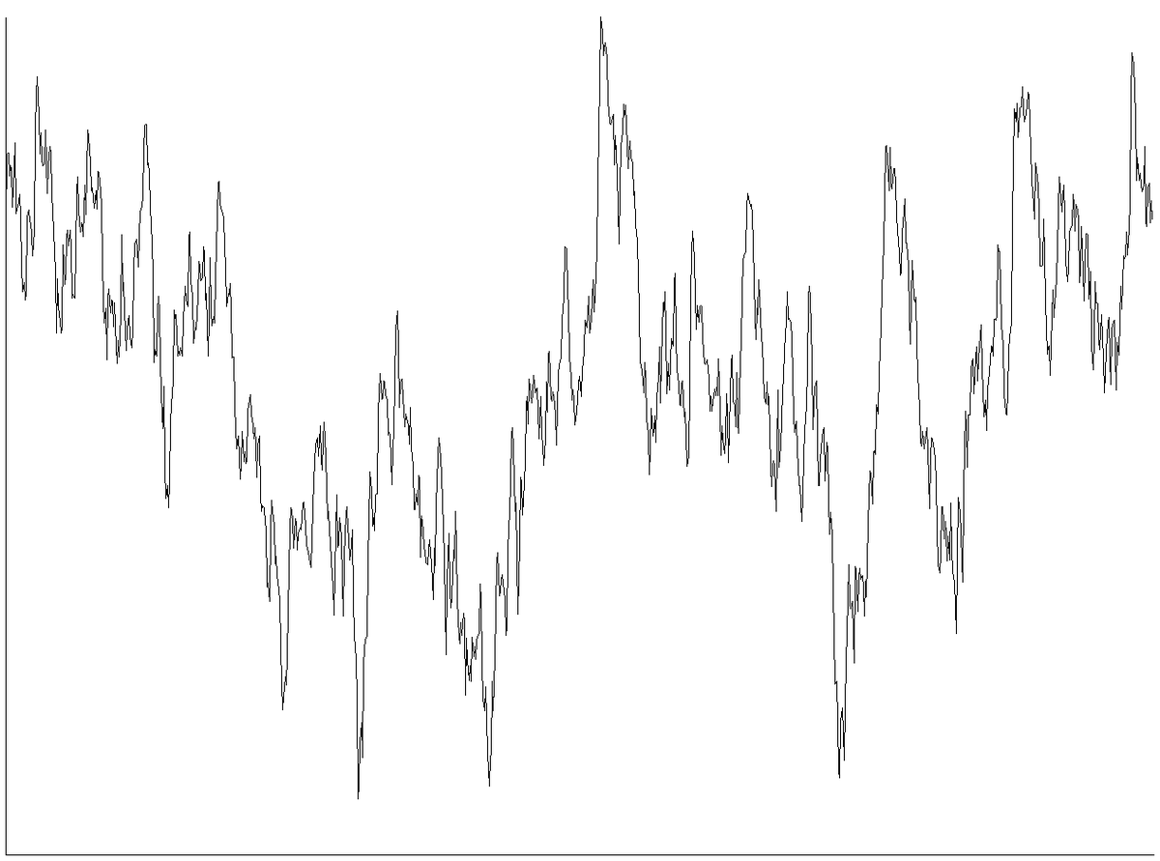
Problem with Push buttons Connected to the Arduino
This is how the signal might look for an unconnected
Wire:
This signal contains noise

Slide 33
Problem with Push buttons Connected to the Arduino
The Arduino reads a voltage value between 3.3 V and 5 V and can mistaken noise values (with voltage levels between 3.3-5V) to real voltage values.

Slide 34
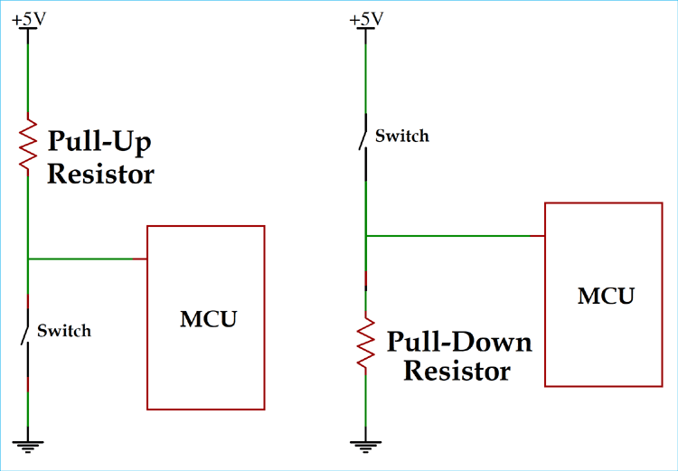
Solution!
Pull-up or Pull-down Resistor

Slide 35
Solution!
Electric current always takes the easiest way to get to the ground.
The resistance of a wire is almost 0 (not really)
So the easiest path to take is a wire with no resistors or with least resistance.
That’s why we use a pull-up/down resistor
to make the current flow to the path we want.

Slide 36
Solution!
Pull-up or Pull-down Resistor

Slide 37
FINAL CHALLENGE

Slide 38
Thank you for attending the workshop.

Slide 39


